Slide 1
Process Description and Control
Chapter 3
Last Updated 1/24/2018 11:37 AM

Slide 2
What is a Process?
An executable image (program) loaded into memory and executed / managed by the operating system (see next slide).
Three important elements of a Process are:
The program instructions (that may be shared by other process).
The program data & stack that is owned by the process.
The Process Control Block.
The PCB maintains the current state of the process including:
The process identification information.
The processor’s current state i.e. CPU registers, data, etc.
A set of OS allocated system resources e.g. files, sockets, etc..

Slide 3
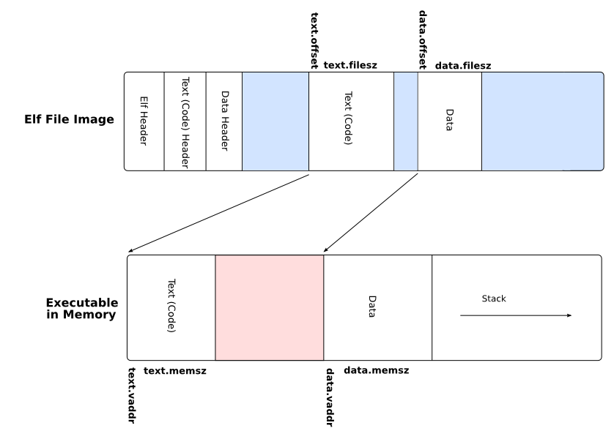
Linux Executable File Image
Notes:
Executable file (ELF) headers contain information describing the image and what the image needs to execute e.g. dynamically loaded libraries (DLL), etc.
Text.offset and text.filesz is the location of the executable’s text region in the file.

Slide 4
The Process Image is the Physical Manifestation of the Process
The Process Image consists of…
A Process Control Block.
The program’s instructions , data (heap), & control stack(s).
In a multi-threaded OS, every thread maintains its own control stack.
A Process’s Image is maintained on the swap disk drive.
As the process executes, portions of the image is loaded from disk into physical memory.
Virtual memory implements the moving of needed portions (pages) of the process image between swap disk and memory.
Notes:
When a process is suspended, what must be done to the process image stored on disk? It must be updated with the contents of main memory.

Slide 5
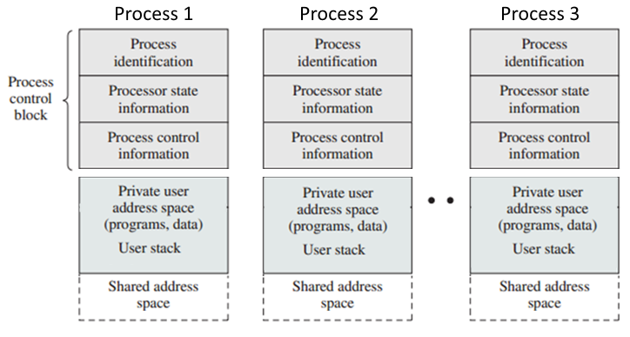
Generic Process Image
The shared address space contains physical memory that can be accessed by multiple processes (AKA Shared Memory).
This space may contain shared libraries (DLL), I/O Buffers, or shared memory used for Inter-Process Communication (IPC).
Notes:
Note at this point we have multiple processes resident in physical memory.

Slide 6
Process States
In a Multiprocessing OS, a process may be Running or Ready To Run.
See next slide.
The operating system provides a Dispatcher Service that:
Selects which of the ReadyToRun processes are to be executed.
Installs the process’s context from the Process Control Block.
Allows the process to execute for an allowed duration (timer interrupt) or until a blocking system call is made e.g. I/O request.
Records the process’s context.
Go to 1.
See Figures 3.3 & 3.4 in text.

Slide 7
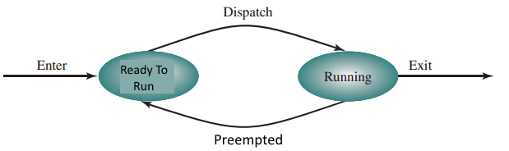
Two-State Process Model
The simplest example of a Process’s state is:
When a process is created, the OS initializes its PCB with a state of ReadyToRun.

Slide 8
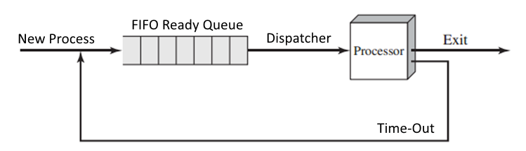
Waiting Process Queue
Because the OS manages multiple processes, there is a queue of Process waiting to be dispatched.
Waiting to transition from ReadyToRun to Running.
This is an example of round-robin process scheduling.
Round-robin is simple, easy to implement, and starvation free.
Notes:
What does starvation free mean?

Slide 9
Process Creation
The OS is responsible for creating processes.
The OS creates a new Process Control Block and the new Process Image containing instructions, data, & stack.
A process may be created:
When a user logs onto the system i.e. hosting the shell.
When commands are executed from a batch or script.
When an existing process requests a new process be created (forked in Unix terms).
The creating process owns the newly created process.
Creating Process: Parent Process
Created Process: Child Processes
Notes:
Start a bash.
Start vi and demonstration the parent-child relationship.
Demonstrate killing the bash pid.
Use the shell command exec /bin/ls /proc ?

Slide 10
Process Can Be Terminated For Many Reasons
Normal Completion: The program “exits” using a syscall.
Parent Termination: A parent process exits which triggers the OS to kill it’s child processes.
This is default behavior can be overridden.
Parent Request: A parent process specifically ‘kills’ the one of its child processes.
Traps: The process has attempted an illegal operation such as reading protected memory or a zero-division error.
See Table 3.2. for several other reasons.

Slide 11
Five State Process Model
Not every not-running process is ready-to-run.
Some processes execution may be blocked while executing a blocking system call e.g. waiting for a I/O request to complete.
Some processes may choose to wait until signaled by the OS.
The Five-State Model takes into account that some processes are un-schedulable until the event has occurred.
Processes that are ready to run are in the ‘ready’ state.
Processes that are waiting for an event are in the ‘blocked’ state.

Slide 12
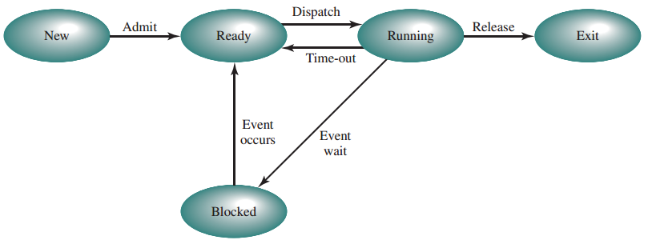
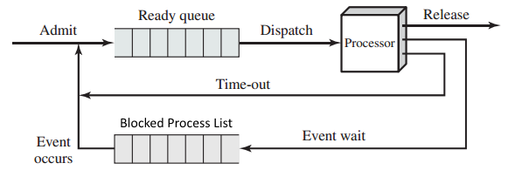

Slide 13
Suspended Process
The OS can place a Process into a “suspended” state.
A suspended process is not scheduled for execution.
Suspension is helpful if a user wishes to prevent a process from running, but does not want to terminate the process.
A suspended process does not consume processor and I/O resources and will free its allocated memory (see Virtual Memory).
This is helpful if the overall system is over capacity i.e. too many executing processes.
A user or second process uses the SIGSTOP signal to suspend a process and SIGCONT to resume a process.
Notes:
See https://major.io/2009/06/15/two-great-signals-sigstop-and-sigcont/

Slide 14
Six Process States
New: A newly created process whose PCB has been created but is waiting on memory and other resources to be allocated.
Running: The process is currently executing.
Ready: The process is ready awaiting its turn to be executed.
Blocked: The process is waiting for pending I/O, a requested resource to be allocated, or other event to occur.
Suspended: The process is temporarily suspended from execution but is not terminated (exited).
Exited: The process has completed execution and is ready for the OS to clear its PCB and allocated resources (memory, files, sockets, etc.).

Slide 15
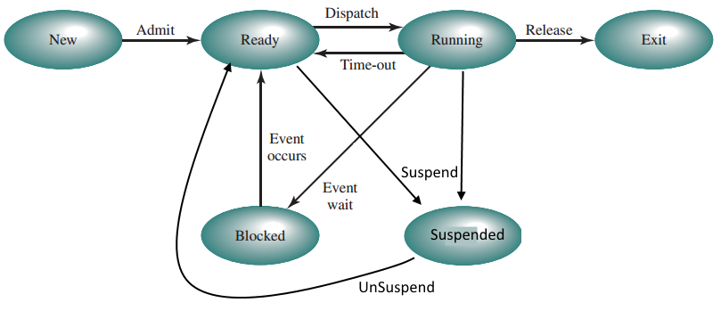
Integrating Blocked and Suspended States
Notes:
Ask about new to ready/suspended.
Ask about running to ready/suspended.

Slide 16
Unix Signals (aka Traps)
Signal is a mechanism provided by Unix that is used to signal (send an event to) a process.
The process responds to a signal by executing a signal handler routine (much like an interrupt handler).
Processes are created with default handlers but some of the defaults can be overridden by the process itself.
Some examples of Unix signals are…
SIGKILL | Terminate Signal
SIGALARM | Timer Signal
SIGUSER1 | Application-Specific Signal
SIGUSER2 | Application-Specific Signal
SIGSTOP | Stop (Suspend) Execution Signal

Slide 17
Inter-Process Communication
A process can setup a signal handler function which is much like an interrupt handler.
The handler is assigned to specific signals e.g. SIGUSER1 & 2.
The handler function is executed when the process receives the appropriate signal number.
A process can signal a second process knowing the signal Process ID (PID).
See system call kill(PID, SIGNUM).
If a system’s implementation is split between two processes, P1 can trigger some action is P2 by signaling P2.
This is one form of several inter-process communication techniques provided by an OS.
Notes:
The Unix syscall kill(pid, signum) sends the given signal to the given process id.
The Unix syscall signal(signum, sighandler*) associates the given signal (number) with the signal handler function on the calling process. This allows the program to override the default signal handler with application-specific behavior.
See Wiki Page: https://en.wikipedia.org/wiki/Unix_signal or Google “Unix Signals”

Slide 18
System Resource Management
An OS is fundamentally a resource management program.
It controls each process’s access to the system’s resources.
It ensure that each process is given fair access to resources.
It attempts to maximize the utilization of I/O devices and other system resources.
The OS maintains information about the current state of processes and the process’s allocated resources.
The allocation (assignment) of resources to processes.
Processes gain access to system resources by making allocation requests through system calls (syscalls).

Slide 19
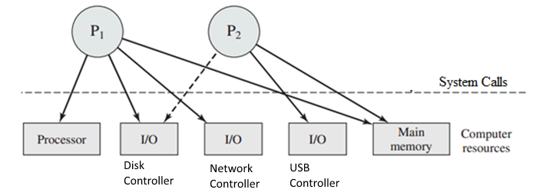
Resource Allocation Graphs
In the following Process Allocation Notation…
Some processes have access to resources
Some process are blocked waiting for resources to be made available.
Notes:
These graphs are snapshots in time of the state of resource allocated by the OS.
Solid lines are current assignments of a resource to a process i.e. P1 ‘owns’ the Processor and so is the currently running process.
Dotted lines are requests for future access to the resource i.e. P2 is requesting ownership of I/O that is currently owned by P1.

Slide 20
Resource Categories Managed by an OS
Memory: Physical memory installed in the system.
I/O Devices: Controlled access to managed devices e.g. I/O.
OS Resources: Data structures maintained by the OS.
The file system e.g. disk blocks and allocating file descriptors.
Pipes, semaphores, queues, and other inter-process communication mechanisms.
Sockets and other network communication mechanisms.
Processes: The creation and management of processes.
Process Control Blocks and other information used to manage processes.

Slide 21
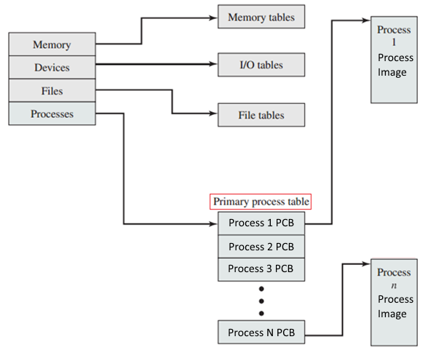
Protected Kernel Data Structures
OS
Kernel
Notes:
In this example, the PCB is maintained separately from the Process Image so that the image can be removed from memory (suspended) and the process information (PCB) can be retained in memory to handle interrupts and events associated with the suspended process.

Slide 22
Process Control Block
Every process is associated with the information needed by the operating system to manage the process and its allocated resources.
This information is stored in a Process Control Block assigned to every process.
The information in a PCB falls into three categories.
Process Identification Information
Processor State Information
Process Control Information
See Table 3.5: Typical Elements of a Process Control Block.

Slide 23
Process Identification Information
The Process’s unique ID (PID).
Identifies the process’s entry in the process table.
The PID is needed to manipulate the process e.g. kill.
Identifies the owner of resources assigned to the process.
The parent process’s ID. (PPID).
The authenticated user’s ID (UID).
The ID of the user owning the process.
Used to determine resource privileges that are based on ownership e.g. who owns a file.
The user’s group ID (GID).
Another mechanism used to determine resource privileges.
Notes:
A “Group” represents a set (group) of users with similar privileges e.g. student, instructor, administrator.
A user can be assigned to multiple groups.
Resources are given ‘group permissions’ that describe which groups can access a resource e.g. a file.

Slide 24
Processor State Information
Maintains the state of the Processor when the process is interrupted including the context switch.
Is used to restore the process so that it can resume execution where it was interrupted.
Including user registers, the processor’s status word, control & status registers, stack pointers.
Program Counter: The currently executing instruction.
Processor Context: Contents of processor registers and other information needed to swap a process out of & into execution.
This information is OS and processor specific.

Slide 25
Process Control Information
Information used by the OS to schedule and manage the execution of individual processes.
Processing State: Running / Ready / Blocked-IO / etc.
Priority: Scheduling Priority relative to other processes.
Scheduling Information: Information needed by the OS scheduler used to determine when to schedule the process for execution.
Memory Management: Information describing the memory allocated to the process including the page table.
Owned Resources: The files, sockets, semaphores, and other OS-managed resources allocated to the process.
Accounting Information: Clock Time, Processor Time, Quotas, etc

Slide 26
Accessing Process Control Information in Linux
Use a SSH client (such as putty) to log onto a Linux server.
For example cslinux1.utdallas.edu with you netID and password.
Use ps -l to get the process id (pid) of the bash process.
Change to the /proc/<pid> directory and observe the process attributes contained in this ‘magic’ directory.
The /proc file system contains directories that represent every executing process.
Every process directory contains pseudo files each of which maintains some aspect of the process’s PCB.
Notes:
Demonstrate ps -e
Chase ownership up to the root.
Demonstrate /proc/<pid>
Kill the process.

Slide 27
Context Switching vs Mode Switching
A context switch occurs when the OS interrupts the currently executing process and selects a different process to execute.
The currently executing process is moved from the running state to the ready or blocked states.
The next process to be scheduled is moved from ready to running.
A mode switch occurs when the OS interrupts the process and the processor switches to its kernel mode of execution.
See next slide.

Slide 28
Modes of Execution
Operating systems require the Processor to operate in User Mode(restricted) and Kernel Mode (privileged).
User program instructions execute in a user mode.
While in User Mode…
The program can not manipulate the Program Status Word (PSW) register and other privileged registers.
The program can not execute privileged instructions including I/O control, memory management, and others.
The program can not access restricted memory including the kernel memory, resource tables, I/O buffers, and others.
The program can not access memory owned by other processes.
Notes:
Intel Privileged Instructions: https://support.microsoft.com/en-us/kb/114473

Slide 29
Managing the Processor’s Mode
How does the processor know its current mode?
PSW register maintains one or more bits that indicate the mode.
Intel processors use two bits called the Current Privilege Level.
How is the processor’s mode changed?
When an interrupt occurs, the processor saves and then clears CPL bits setting the processor into kernel mode.
The processor executes the handler’s instructions which includes accessing protected memory, privileged instructions, etc.
At the end of the interrupt handler code, the Return From Interrupt (IRT) instruction is executed and the processor restores the CPL to its pre-interrupt state including returning to user mode.

Slide 30
Triggering a Context Switch
A context switch can occur when the OS gains control (i.e. preempts) from the currently executing process
Four mechanisms that can preempt a process’s execution:
Interrupts and Traps(Signals) are reactions to events that occur outside of the process’s control.
Hardware interrupts or math errors detected by the ALU.
Blocking System Call (SYSCALL) is mechanism that allows the running process to invoke OS services(read(), write(), etc.).
Hardware Interrupt | React to external events
Timer Interrupt | React to scheduling event
Signals(Traps) | React to error in process execution
Blocking System Call | Call to OS service
Notes:
Supervisor Call is the book’s name for System Calls or syscalls

Slide 31
Steps of a Context Switch
Save the information needed to restore the process.
Save the processor context, page table, and other state in the PCB.
Change the process’s state (From Running to Ready or Blocked ).
Move the process to the correct queue e.g. READY, BLOCKED, etc.
The dispatcher selects the next process to be scheduled from the READY queue.
Restore the selected process’s Processor Context from the PCB.
Restore the information saved when the selected process was last swapped out.
Update the selected process’s state i.e. change state to RUNNING.
Resume execution of the selected process where it was last interrupted.
Notes:
PSW = Program Status Word
PCB = Process Control Block

Slide 32
Mode Vs Context Switching Does every mode switch result in a context switch?
When the process is interrupted, or issues an syscall, it needs to ‘mode switch’ to allow the execution of kernel level (privileged) instructions.
In many cases the syscall is blocking and the process will be swapped with the next ready process.
For example, a syscall performing an blocking I/O operation.
In some cases the syscall is not blocking and the process can remain active (running) after the interrupt handler or syscall completes.
For example, opening a file or allocating memory doesn't necessarily cause the process to block.
In these cases the running process can enter and exit kernel mode without becoming blocked.

Slide 33
Creating A New Process (Generic)
Allocate space for the new process image on the swap drive.
The space needed to hold the instructions, data, and stack.
Copy text and data segments from the executable file to the new process image.
Create or expand various kernel data structures.
Initialize a new Process Control Block (PCB), page table, etc.
Create accounting, log events, and other housekeeping activities.
Assign a unique Process ID (PID) to the new process.
Assign the Parent Process ID based on the creating process.
Copy the image from the system drive into main memory.
Set the process to the Ready state in the Ready-Queue.

Slide 34
Creating A New Process (Linux)
A process invokes the fork() system call.
Fork() causes a new process is created by duplicating (cloning) the calling process.
Fork creates a new process where both process have an identical process images and process states.
The parent – child relationship is determined by the value returned by fork().
Fork() returns the new process PID in the original parent process.
Fork() returns 0 in the newly created child process context.
The child process invokes the exec(‘exe_file’) system call.
The exec() call replaces the currently executing process image with the process image created from the executable file.
Notes:
The child process gets copies of files and sockets opened by the parent.
The code that starts a new Unix / Linux process looks something like
startProc(execFileName) {
int pid = fork();
if(pid == 0) {
// Child Process
exec(execFileName);
}
See interesting stack overflow discussion about what the child process inherits, and does not inherit, from the parent process. http://stackoverflow.com/questions/5021296/child-parent-relationship-and-inheritance-in-c

Slide 35
Operating System Structure (Software Architecture)
If the operating system is just another set of instructions (i.e. a program), what is its structure / design / architecture?
How is the operating system architected?
How are Kernel and User Processes maintained in memory?
How does the user process make requests for OS services?
The book identifies these OS implementation strategies:
Monolithic Kernel Architecture
Microkernel Architecture
Others…

Slide 36
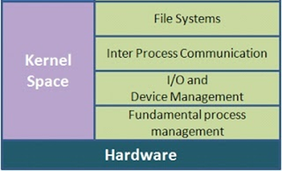
Monolithic Kernel Architecture
The “kernel” is assembled as single monolithic program that is loaded into memory when the system boots.
See Linux Boot Sequence on slide “OS Initialization”.
All system services are implemented in the kernel program.
I/O and resource management routines (syscalls)
Process Creation and Scheduling
Memory Management
Interrupt and Signal Handlers
File Systems
Network Protocol Stacks
Device Drivers
The kernel’s data structures.
Notes:
This is the model for Linux operating system. See http://superuser.com/questions/197168/is-kernel-a-process
Linux kernel can't be considered as a process, because this is one of its responsibilities to manage processes. However, during the system boot, the kernel starts a process “init” which is the root (parent) process of all the remaining process started during system initialization.
You can consider kernel as a big interrupt handler. After the kernel grants processor to the thread, the only way to get control back are interrupts (or system calls, which are also interrupts). When interrupt occurs, kernel immediately gets control, and appropriately handles interrupt. At this point various parts of kernel could be called.
Kernel is multi-threaded as it can handle various interrupts on different processors simultaneously. On the other hand, there are kernel-threads, which are managed in the same way as user threads (there is no difference between kernel and user threads for scheduler).

Slide 37
Kernel-Mode Stacks
When the process is operating in Kernel Mode its instructions operate on a separate Kernel-Mode Stack.
The kernel stack is located in protected (kernel) memory.
The KMS exists to keep the user process from corrupting the operating system by manipulating variables and addresses stored on the stack by the kernel’s instructions.
In Linux, each process (thread) maintains a separate KMT used to execute SYSCALL issued by the thread.
See this excellent description on Stack Overflow
Notes:
http://stackoverflow.com/questions/12911841/kernel-stack-and-user-space-stack

Slide 38
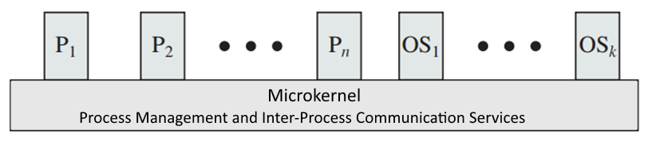
Microkernel Architecture
A microkernel implements only those services needed to support process execution.
Process Creation and Process Scheduling
Virtual Memory
Fast inter-process communication.
All other OS services are implemented as Kernel Processes.
Notes:
https://en.wikipedia.org/wiki/Microkernel
Instead of bundling all system services implementations (instructions) in a single monolithic kernel, services are partitioned into cohesive services.

Slide 39
Microkernel Services
OS Services described as part of the monolithic architecture are instead implemented as separate kernel processes.
Networking, File Systems, Device Drivers, and other OS services are implemented as user processes.
User application processes are clients of these OS servers.

Slide 40
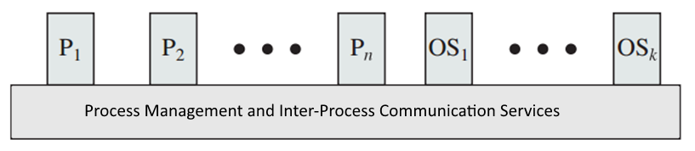
Microkernel Architecture
A Microkernel makes for a modular OS design that can be easy to extend with new or modified server processes.
Instead of recompiling a monolithic kernel with new or modified services, server processes can be added or replaced¹.
Microkernel architectures have more overhead as every OS service request requires an IPC and context switch.
Notes:
1. Note that Linux is a monolithic kernel that uses ‘modules’ to load new services into kernel memory. Modules serve the same purpose as MK Server Processes in that they encapsulate the implementation of OS services such as filesystem, network stacks, etc. Linux Modules can even be loaded & unloaded from the kernel without a system restart.

Slide 41
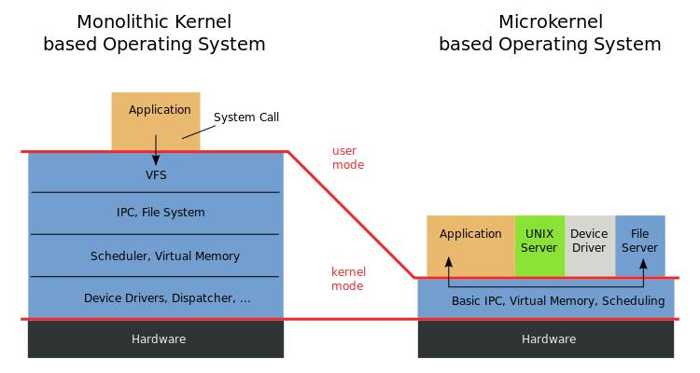
Monolithic vs. Microkernel Architectures
Difference between an application requesting file services.
Notes:
https://en.wikipedia.org/wiki/Microkernel

Slide 42
Monolithic vs. Microkernel Architectures Which is Better?
Microkernels have more ‘modularity’ and so are easier to extend and maintain from a software development POV.
Services (processes ) can be started as needed.
Microkernels are considered more reliable as a single failed service (process) does not crash the whole system.
Monolithic kernels are faster as requesting a service does not involve message passing and context switching from one process to another.
Monolithic kernels use less resources (e.g. memory) as all service run in a single image.

Slide 43
Hybrid Kernels
A pure Microkernel is too slow for some OS services.
The video card (GPU) requires a high bandwidth interface due the large amounts of data that is transferred between the process (e.g. video game) and the GPU’s memory.
A Hybrid Kernel maps regions of kernel memory into a an OS process.
Providing the process direct access to protected memory, drivers, etc.
A Hybrid Kernel will implement some of services found in a monolithic as separate user process (IPC).
Services that can operate with the low bandwidth IPC channel.
Both Windows NT and OSX are hybrid kernels.
Notes:
Windows NT Kernel Model: https://msdn.microsoft.com/en-us/library/windows/hardware/ff554836(v=vs.85).aspx
https://en.wikipedia.org/wiki/Hybrid_kernel#/media/File:Windows_2000_architecture.svg

Slide 44
Operating Systems Initialization
The kernel is maintained on disk as an executable image.
The “Boot Loader” is a small program that copies the kernel image from disk into memory, and starts its execution.
The boot loader is maintained in static non-volatile memory maintained on the motherboard AKA BIOS memory.
The location of the OS kernel is maintained on the first block of the boot drive AKA Master Boot Record (MBR).
Modern OS use a two stage loader where the first-stage loads a more sophisticated second-stage loader, which loads the OS.

Slide 45
Kernel Startup Procedure
The boot loader copies the kernel program from disk into main memory and starts the kernel’s execution.
Kernel code initializes its internal data structures.
Kernel code mounts the root file system and mounts any secondary file systems as specified in configuration files.
Kernel code probes the installed hardware and initializes the proper drivers.
The kernel starts OS service processes (daemons) that implement network services (init, sshd, HTTP, etc.), GUI, etc. as specified in configuration files.

Slide 46
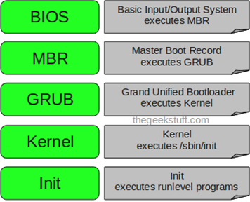
Linux Boot Sequence
During initialization the root process (P0) is created.
In Unix / Linux this is the init process.
Init starts the many service processes (daemons) that support the system’s execution.
Network services, terminals(tty), XWindows, applications, etc.
Notes:
https://en.wikipedia.org/wiki/Linux_startup_process
Do a ps –ef on a linux server and notice all of the daemon processes that are running.
Key point: All of these support processes access OS services in the shared kernel.

Slide 47
Linux Run Levels
The system is set to run at a specific run level.
The command init <lvl> specifies what level to configure the system.
Run Level determines the level of services the system offers to its users.
Run-Level | Run Level Services
0 | Halt
1 | Single-user mode
2 | Basic multi-user mode (without networking)
3 | Full (text based) multi-user mode
4 | Not used
5 | Full (GUI based) multi-user mode
6 | Reboot

